Slide 1

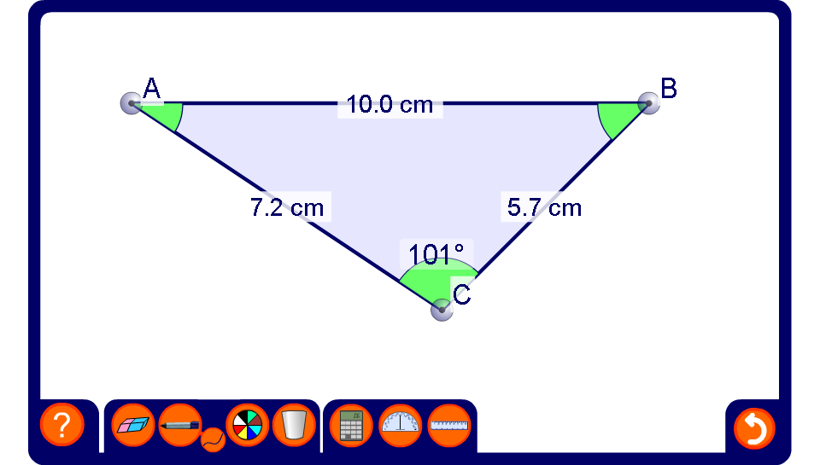


Using the cosine rule to find side lengths
Notes:
Be aware that the lengths of the sides and the angles have been rounded. This means that, for example, the three angles in the triangle may not add up to exactly 180°.
Change the shape of the triangle by dragging on the vertices.
Reveal the lengths of two of the sides and the angle between them. Ask a volunteer to show how the cosine rule can be used to find the length of the third side.
Make the problem more difficult by revealing two sides and an angle other than the one between them.

